Slide 1

Introducing Computer Networks

Slide 2
Through this lecture, students will learn the basics of computer networks with its different topologies.
Learning
Outcomes

Slide 3
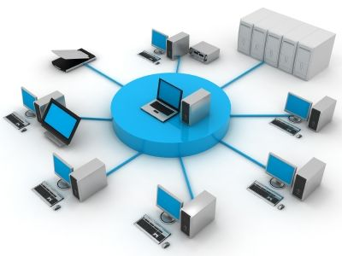

What is Computer Networks?
Devices communicate and share resources
Connects two or more autonomous computers.
Computers can be geographically located anywhere
Connections in network can be wired or wireless

Slide 4
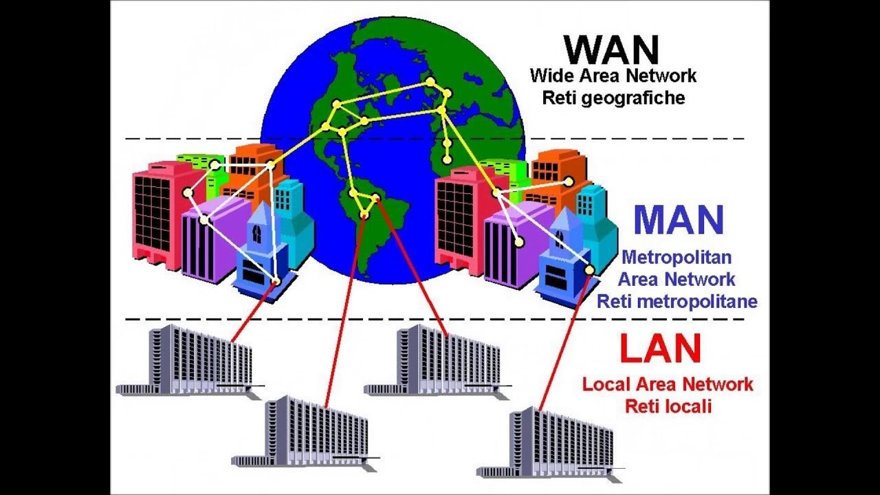
Types of Networks

Slide 5
LAN
Smallest network
MAN
Can be a collection of several LANs within the same city.
WAN
Largest network
Connect two computers together
Operated within limited physical area such as home, school, single or several buildings
Consists of less than 500 interconnected devices across several buildings
Group of computers and network devices connected together within a large physical area
Metropolitan describes important cities like New Delhi, Mumbai, Kolkata, Bangalore etc. and companies that have several branches within city such as banks use MAN.
Internet is the largest WAN in the world which covers large distances such as states, countries or continents.
International banks use WAN to connect their computers all over the world
It is a group of MAN or LAN or mixture of both networks.

Slide 6
Comparison of LAN, MAN, WAN
BASE | LAN | MAN | WAN
Cost | Low | High | Higher
Network Size | Small | Larger | Largest
Speed | Fastest | Slower | Slowest
Transmission media type | Twisted pair | Twisted pair and fiber-optic cables | Fiber optic, radio wave and satellite
Number of computers | Smallest | Large | Largest

Slide 7
Applications of Networks
Resource Sharing
Information Sharing
Distributed Processing
Communication
Remote Computing

Slide 8
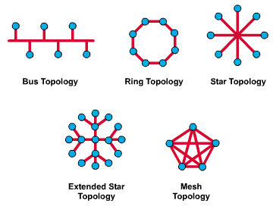
Network Topology
It defines the way in which computers, printers, and other devices are connected.
It describes the layout of the wire and devices as well as the paths used by data transmissions

Slide 9
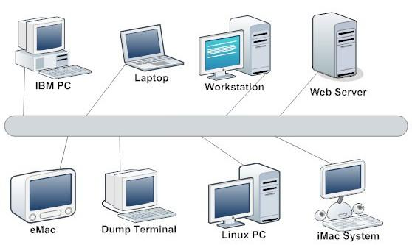
Bus Topology

Slide 10
Single central cable to which all computers and other devices connect
All nodes share the backbone to communicate each other on the network
Very common in LAN
If the backbone is broken, the entire segment fails
Easy to install, and don’t require much cabling, used by Ethernet networks

Slide 11
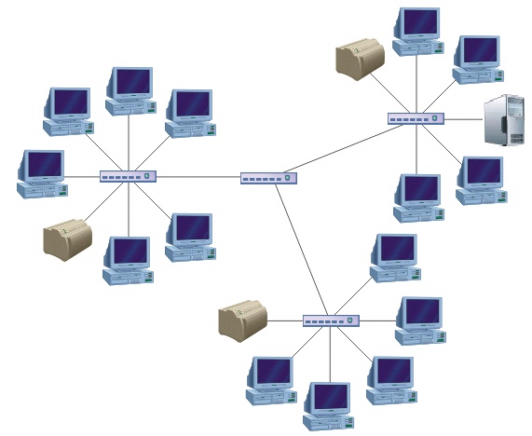
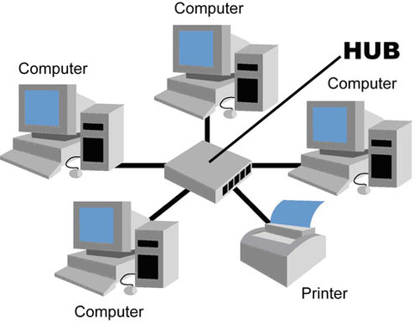
Star Topology

Slide 12
Common architecture in Ethernet LANs
Larger networks use the extended star topology
Central host which connects all nodes to communicate
Host can be a server, hub or router
Every node will not connect to neighbouring nodes

Slide 13
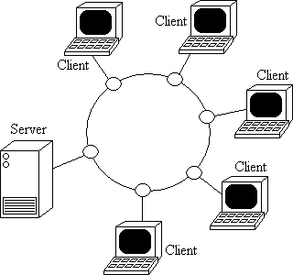
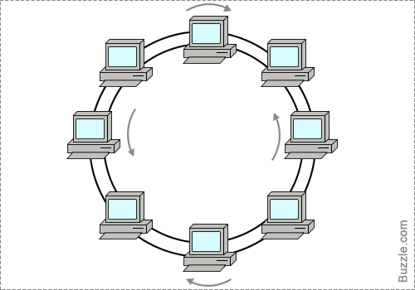
Ring Topology

Slide 14
Computers and other devices connected in a loop
Each node directly connects to two neighbouring nodes
A server may exists but will not connect to all nodes in network
Can be found in LAN
Single ring – All the devices on the network share a single cable
The dual ring topology allows data to be sent in both directions.

Slide 15
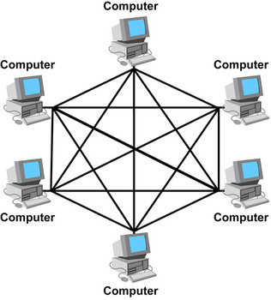
Mesh Topology

Slide 16
Connects all devices (nodes) to each other for redundancy and fault tolerance
used in WANs to interconnect LANs
for mission critical networks like those used by banks and financial institutions
expensive and difficult
Data is automatically configured to reach destination by taking its shortest route
Reliability factor is high, has lesser chances of network breakdown

Slide 17
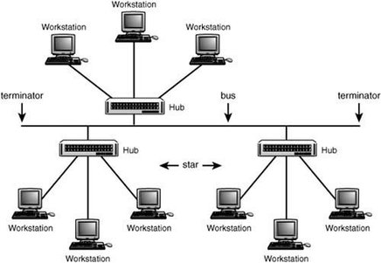
Tree Topology

Slide 18
Derives its roots from bus and star topology.
connected elements are arranged like the branches of a tree
Form parent and child hierarchy
Each node in a hierarchy level has point-to-point links with each adjacent node on its below level
Easier maintenance and fault finding
Huge cabling, lot of maintainence needed

Slide 19
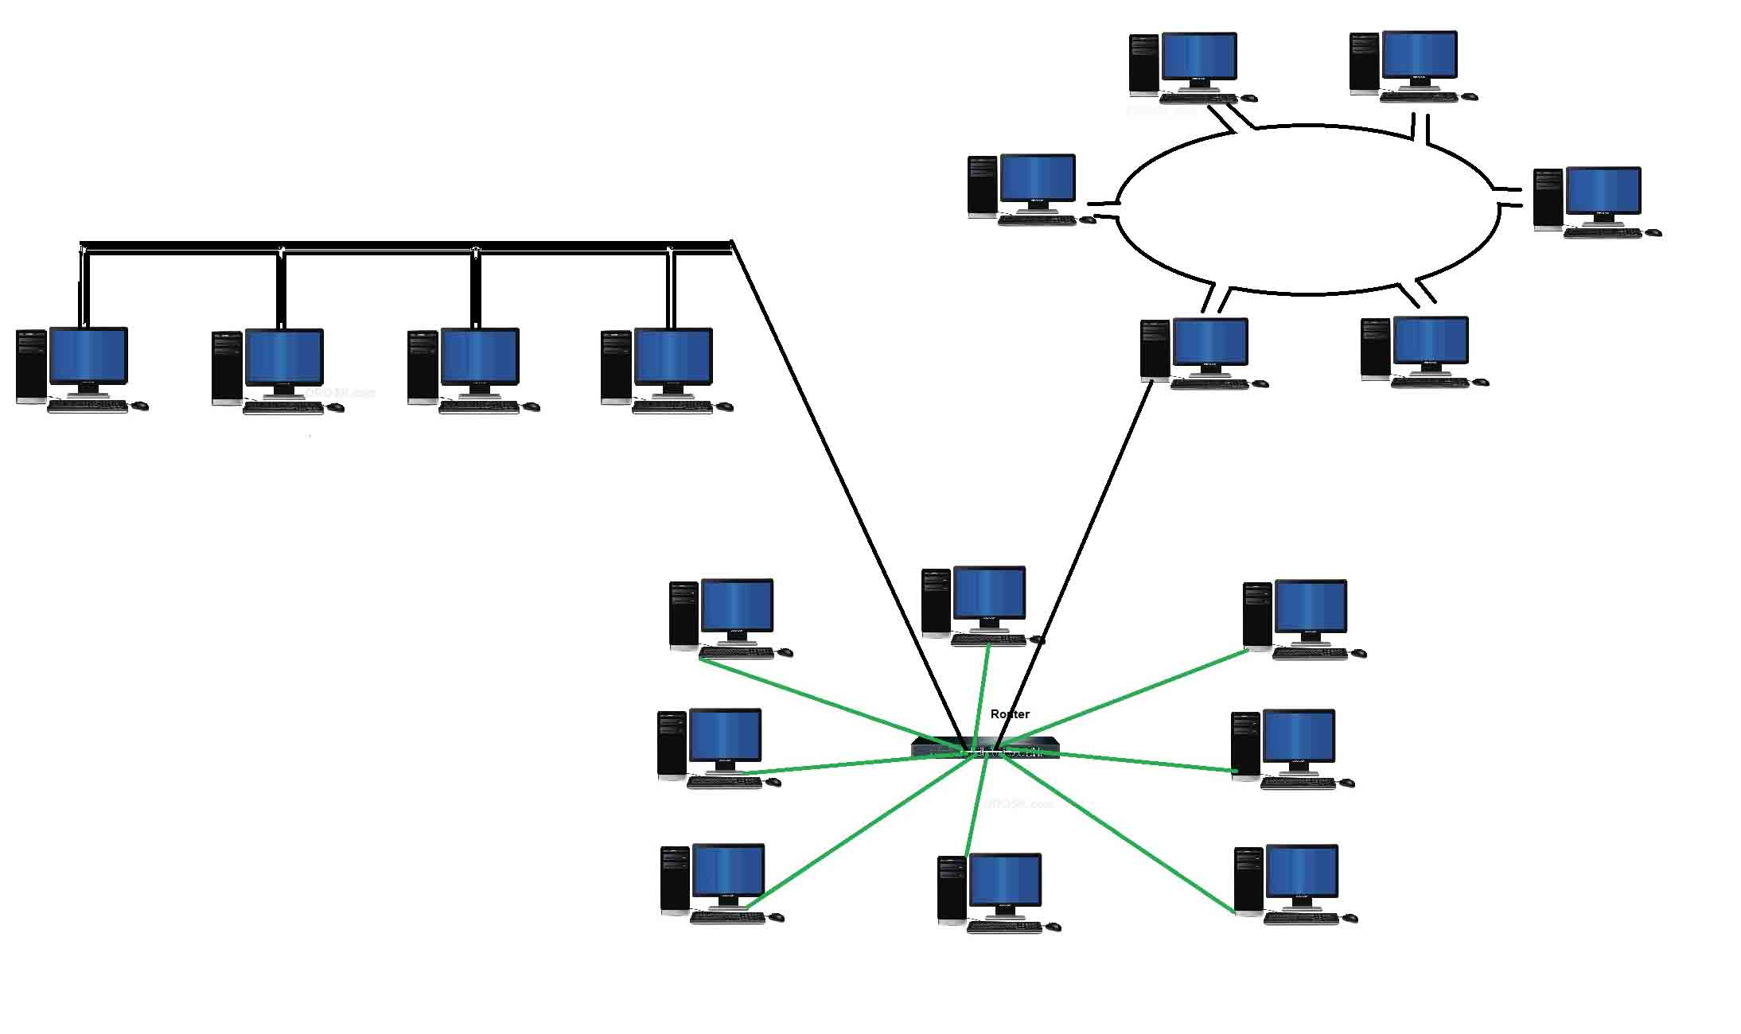
Hybrid Topology

Slide 20
Uses two or more differing network topologies
Star-Ring and Star-Bus networks are common examples
Fault detection and troubleshooting is easy
Easy to increase the size of network by adding new components, without disturbing existing architecture.
Configuration and installation is very efficient
Costly hub, and infrastructure

Slide 21
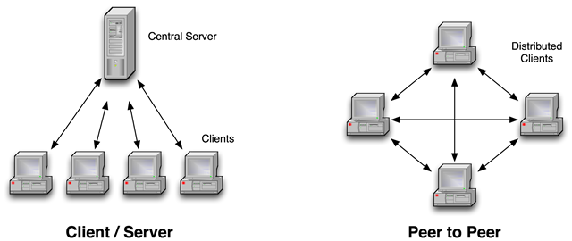
Network Architecture
Overall design of a computer network that describes how a computer network is configured and what strategies are used. Also known as network model or design.

Slide 22
Comparison between client-server and Peer-to-Peer
There is a specific server and specific clients connected to the server
Focus is on sharing information
Data is stored in a centralized server
Expensive to implement
More stable and scalable
Resources may be removed at any time.
Storage and bandwidth must be provided by the host.
Relatively easy to determine who is inserting or requesting content.
Each node act as client and server, clients and server are not distinguished.
Focus is on connectivity
Each peer has its own data
Less expensive to implement
Suffers if number of peers increases in the system
Resources are not removed from the network until they are no longer being requested
Storage and bandwidth are distributed and provided by the entire network
Very difficult to determine who is inserting or requesting content

Slide 23
Applications
E-mail
Searchable data (Web sites)
E-commerce
News Groups
Internet Telephony (VoIP)
Video Conferencing
Chat Groups
Instant Messengers
Internet Radio

Slide 24
Types of Programming Language
Procedural
BASIC
C
Object-Oriented
C++
JAVA
FORTRAN
COBOL
PASCAL
Python
PHP
C#
Scala
Functional
LISP
Perl
Mathematica
Ruby
Scripting
AppleScript
JavaScript
ActionScript
Python
PHP
SmallTalk
VBScript

Slide 25
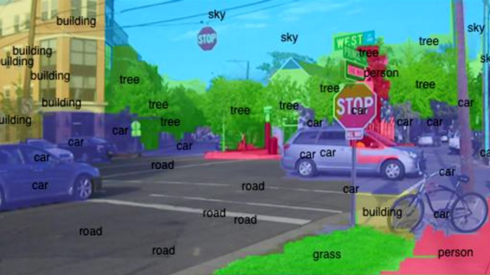

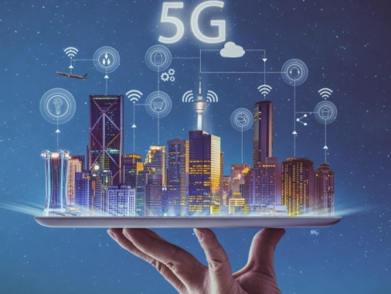

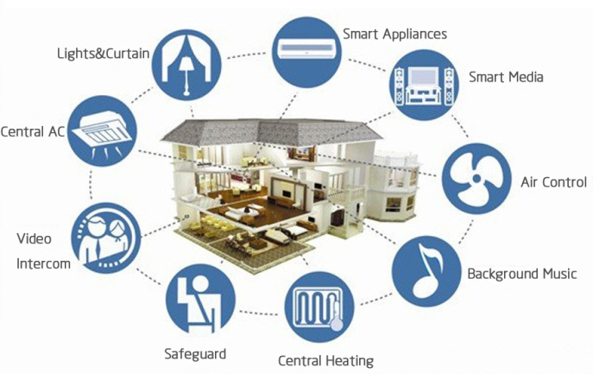

Current prevalent technologies
Computer Vision
Artificial Intelligence
5th Generation wireless
Cloud Computing
Internet of Things
Block Chain

Slide 26
Quiz
A term that refers to the way in which the nodes of a network are linked together. a) network b) topology c) connection d) interconnectivity
A network comprising of multiple topologies. a) Complex b) Hybrid c) Bus d) Star
A topology that involves Tokens. a) Star b) Ring c) Bus d) Daisy Chaining
In which topology there is a central controller or hub? a) Star b) Mesh c) Ring d) Bus

Slide 27
5. This topology requires multipoint connection a) Star b) Mesh c) Ring d) Bus
6. Data communication system spanning states, countries, or the whole world is ________ a) LAN b) WAN c) MAN d) None of the mentioned
7. Which topology covers security, robust and eliminating traffic factor?
Mesh
Ring
Star
Bus

Slide 28
8. Network in which every computer is capable of playing role of client, server or both at same time is called
peer-to-peer network
local area network
dedicated server network
wide area network
9. LAN can use ________ architecture.
Client and server B. Peer–to–peer C. Both a and b D. Neither A or B
10. ________ is the transmission of data between two or more computer over communication links.
A. Data communication B. Data networking C. Networking D. Communication

Slide 29
Thank You

